Slide 1
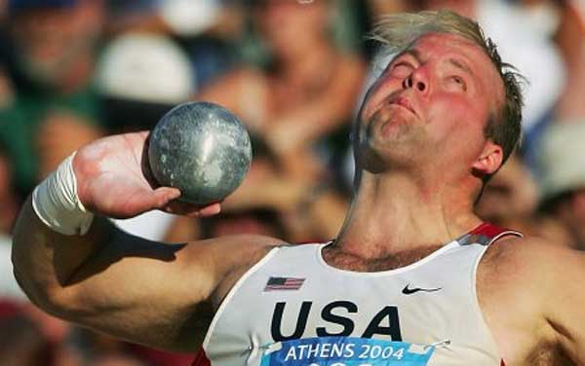
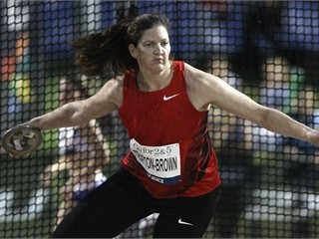
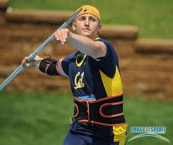
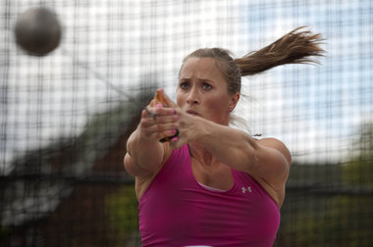
The FOUNDATION OF A
CHAMPIONSHIP
ThrowinG PROGRAM
Lane C Dowell
Retired High School Coach
Longtime Washington State Meet Referee (Tacoma & Cheney)
2005 USATF Field Official of the Year
Head USATF National Championship Throws Official (2000-2008)

Slide 2

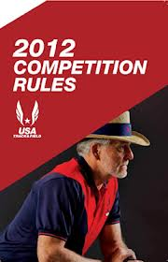

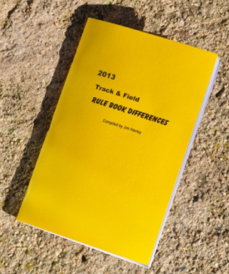
Rules & Case Books
NFHS 2013
www.nfhs.org
Download Available Feb??
NCAA 2013-14
www.ncaa.org
Download Available
USATF 2012
www.usatf.org
Download Available
IAAF 2012-13
www.iaaf.org
Download Available
2013 Rule Book Difference
$12 ($10 cost plus $2.00 shipping) - Quantity discounts
Track & Field Rule Book Differences - Jim Hanley, editor
P.O. Box 6744
Thousand Oaks, CA 91359-6744
Checks Payable to “T&F Rulebook Differences”
To Contact…Jim@Hanley.cc

Slide 3
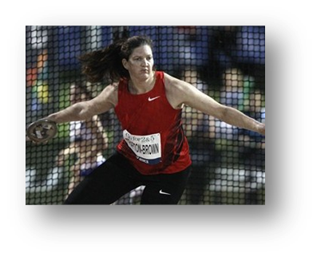
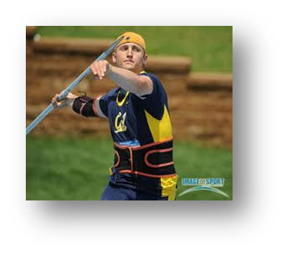
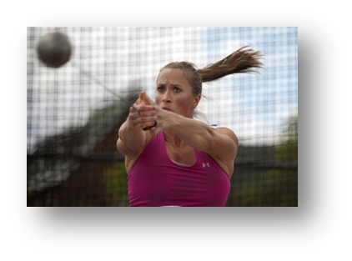
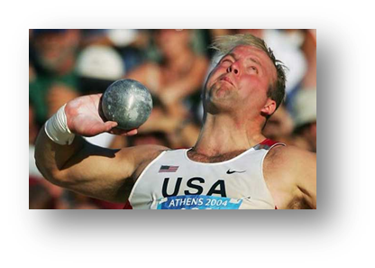
Washington State Champion
Thrower’s Quiz
Who are the two Washington Prep Champions?
What high school did they attend?
In what event were they a state champion?
Which Pac12 university did they attend?
Tie-breaker: Which of these WA prep champions has been a
USATF National Championship Medalist?

Slide 4
Basic Philosophies of
FIELD & track
Respect the sport…adhere to its rules & procedures
SAFETY!!!!…Rhythm…Accuracy…Efficiency
Restore Competition…Eradicate the Open Pit concept.
Exercise good sportsmanship at all times…profanity
It is your obligation to insure all competitors a level playing field…no unfair advantage should be gained (illegal use of photography/video camera etc.).
Vernacular…
  “On Hold”, not “in the hole” …”Foul”/”No Mark” is not “Scratch”
  Title of the sport is Track & Field
  Athletes should be addressed by their surname

Slide 5
Games Committee
The Games Committee is not the Jury of Appeals
See decisions to be made in the 2013 NFHS Rule Book.
Plan early with knowledgeable volunteers
For smaller meets…the home head coach
Note the body of rules that will govern the competition.
Key decision examples:
  “Scratch one – Scratch all”
  Excused time

Slide 6
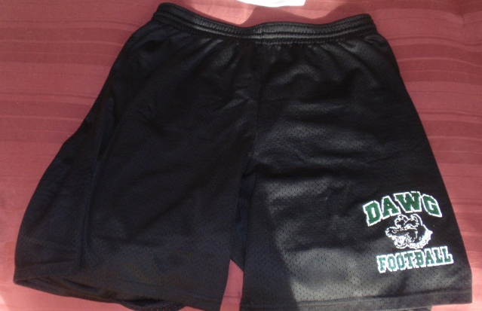
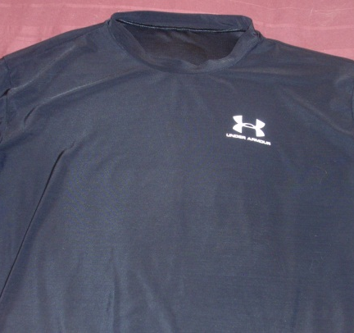
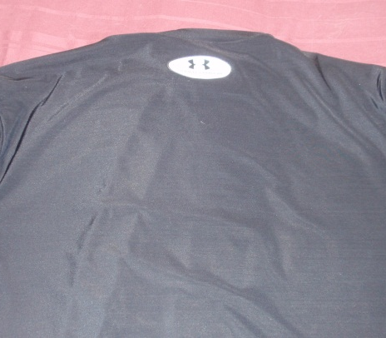
Uniform & Jewelry
Athletes must be dressed in a school-issued track & field
uniform.
Note changes in 2013 NFHS Rule Book
  Any athlete competing with an illegal uniform or adorned
with unacceptable jewelry shall receive a warning
  If the athlete is discovered the 2nd time inappropriately
attired he/she shall be disqualified from the competition.
(Same undergarment: Front – Back)

Slide 7
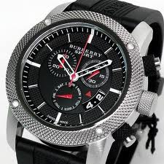
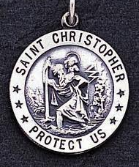

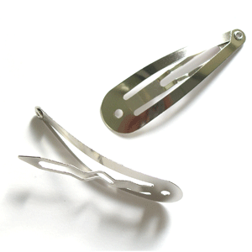
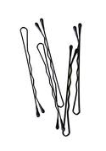
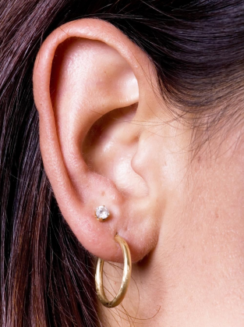
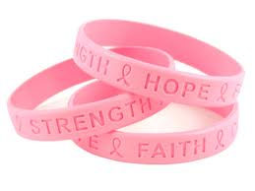
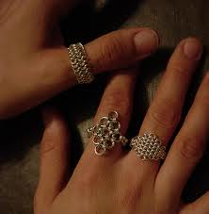
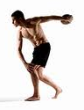
Uniform & Jewelry (con’t)
One acceptable
Metallic…taped beneath uniform
No longer than 2”
Not acceptable
Any piercing…
Not acceptable
Not acceptable
Removal of uniform…
in competition area
Not acceptable

Slide 8
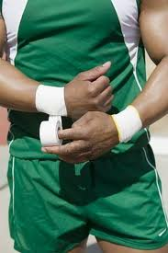
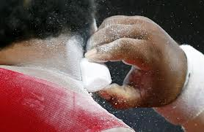
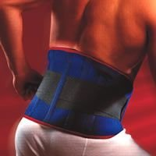
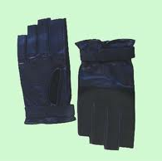
Aids Allowed Athletes
No tape may be applied to an athlete’s hand unless covering an OPEN wound
Note difference in USATF Rule Book which would apply to Youth/Jr. Olympic
competitions
With the exception of the Hammer, no gloves are allowed.
A support belt may be worn
A rosin/chalk/pine tar may be applied to the hands.

Slide 9
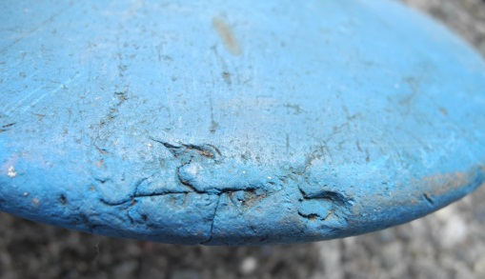
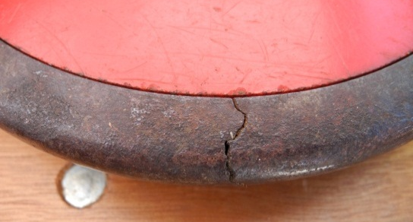
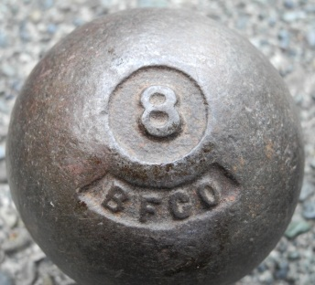
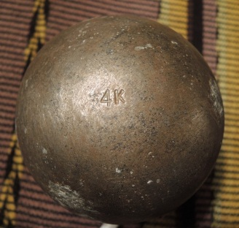
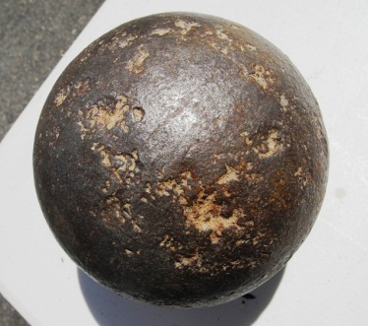
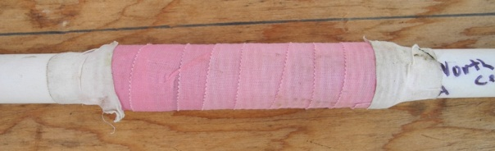
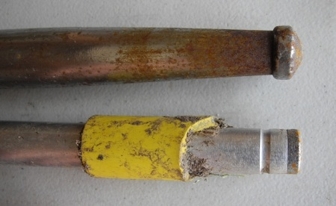
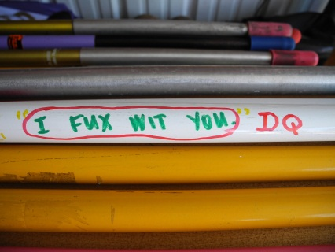
Weights & Measures
Equip your athletes with legal quality implements to avoid disqualification
To maximize your warm-ups, check implements into Weights & Measures early
Examples of disqualified implements
(legal shot put)

Slide 10
Pre-competition
All athletes competing in an event MUST check-in
with the head judge
prior to the start of competition.
Warm-up
Be SAFETY conscious at ALL times
Only implements that have passed inspection.
Only under supervision of an official or designated coach
All warm-ups cease when the competition begins
Instruction/Inspection
Check for proper taping
Check for proper uniform & jewelry
Check for legality of implements
Comments/questions about competition

Slide 11
The Competition
Up – On Deck – On Hold
The competition begins once the 1st athlete is called “Up”
No warm-ups with implements are allowed once the competition begins
Once called up he/she has 60 seconds to start a trial.
The athlete may enter the circle/runway anyway he/she wishes
When entering the ring, a break in the athletes momentum must occur
(South African drill…discus) prior to starting the trial .
The athlete may stop a trial and restart but her/his TIME does not reset.
A foul may only be committed during the act of throwing

Slide 12
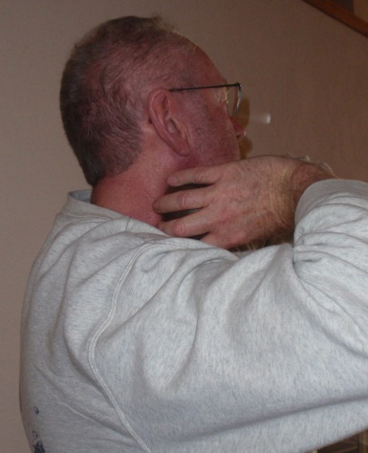
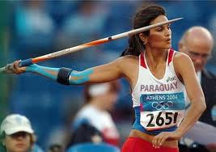
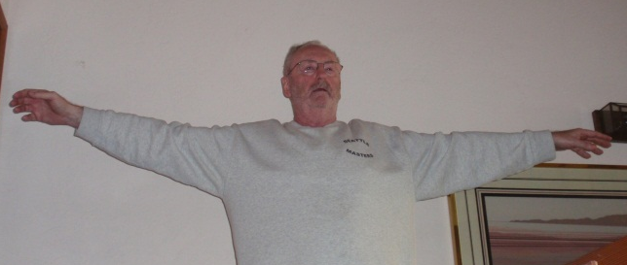
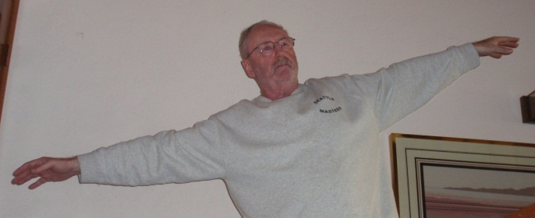
Form Fouls
Shot Put must be thrown above and in front of the shoulder.
(as per 2013 rule change 6-5-9…the cartwheel technique is not allowed).
Javelin must be thrown above the line of the shoulders.
(a spinning/360 degree approach is not allowed)

Slide 13
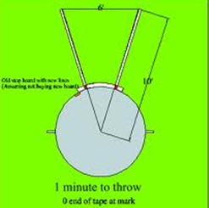
Sector Fouls
A foul is committed when the implement lands
touching any part of the sector line.

Slide 14
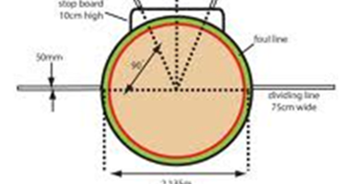
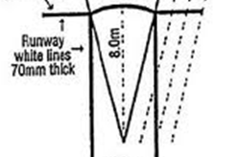
Foot Fouls
A foul is committed during the throwing motion…
By stepping on the ring boundary/javelin arc
Improperly exiting the throwing area
See “Mark Rule”

Slide 15

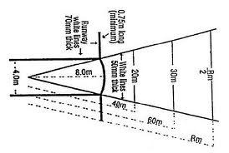

The Mark Rule
(Very Underemphasized)
Once the athlete’s implement lands & it is a fair throw, the judge will say, “Mark.”
This is the signal that the athlete may leave the ring/runway via the back half.
The back-half of the ring is noted by side-markers …outside the ring/runway.
These “side-marker” lines on the ring should be 8” in length by 2” in width.
Javelin “side markers” are 2’-5 ½“ long by 2 ¾“. They extend to infinity.
The back of these lines indicate the beginning of the back half of the ring or
fair ground to exit the javelin runway.

Slide 16
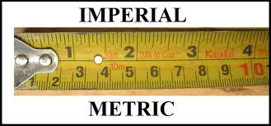
Measurement
The zero end of the tape is placed where the implement breaks ground/lands
closest to where it was thrown.
If the javelin should land flat the marking is from the back of the javelin’s grip.
The tape is pulled through the center of the ring/arc (26’3”from the arc) and
measurement is taken from the inside edge of the ring (shot put stop board)
or javelin arc.
Shot Put…nearest lesser quarter-inch
Long Throws…nearest lesser inch

Slide 17
Placement of Athletes
Flights of no fewer than 5 should be drawn by lot
3 preliminary trials shall be taken in the order in which the competitors are listed
(2013 rule change 6-2-2)
In a multi-flight competition, the referee may allow an athlete to change flights or
the order within the flight.
  The head judge may alter the throwing order to accommodate an excused athlete
  One more athlete than places awarded shall advance to the finals.
  If there is a tie for the last qualifying spot for the finals, all athletes shall advance.
  The final 3 throws shall be taken in reverse order…best throw throws last.
  If a tie exists at the end of competition, it is broken using the second best throw
  and so on…

Slide 18

Protests
  Protests may be filed with the referee up to 30 minutes after the competition has
  been completed.
    They should be written and must be based on a rules/procedures misapplication.
    Judgments cannot be protested.
    Referees decision may be taken to the final arbiter, the Jury of Appeals.

Slide 19
2014 Rule Additions & Changes
Rule 4-3-1c(7) was modified to require only those visible garments
worn under the uniform bottom that extend below the knees to
be unadorned and of a single, solid color.
Rule 3-2-8 now permits the use of electronic devices in unrestricted
areas and coaching boxes
Rule 6-6-1 Note, specific diameter dimensions of the javelin’s rubber
tip were removed from the rule to align with the current process
of manufacturing the equipment.
Rule 6-2-9 requires a pass to be communicated to the event judge by
the competitor before the start of the trial clock.

Slide 20
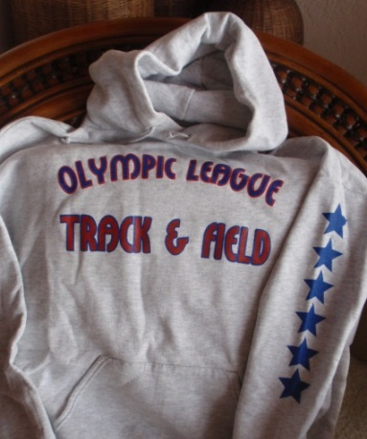
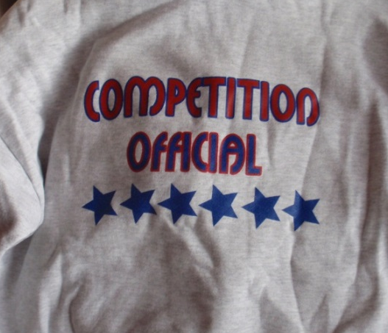
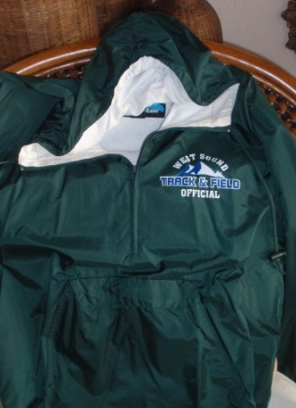
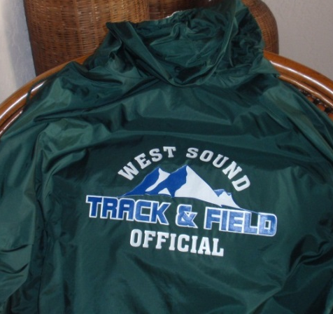
Creating an Officiating Base
See articles on the “Kent Plan”…Spring & Summer issues of Washington Coach.
Give them the tools to successfully administer a competition:
  Another reliable official to mark in the field.
  A copy of applicable rules
  A waterproof results sheet
  House implements, towels, clipboard, pencils, broom, rake, etc.
At the end of your home season, show your appreciation of a job well done
by purchasing them a piece of officiating apparel
Provide training using experienced area USATF officials
Create and distribute a list of trained/experienced local officials to area
  coaches/ADs.

Slide 21



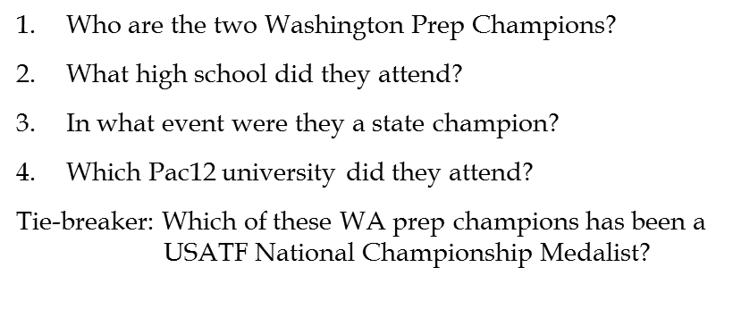

Washington State Champion
Thrower’s Quiz

Slide 22
Champions Quiz
Ryan Young…North Kitsap (Poulsbo)
2x State Javelin Champion
University of California (Berkeley)
Brittney Henry…Lewis & Clark (Spokane)
State Hammer Champion
University of Oregon (Eugene)
USATF National Championship Medalist

Slide 23
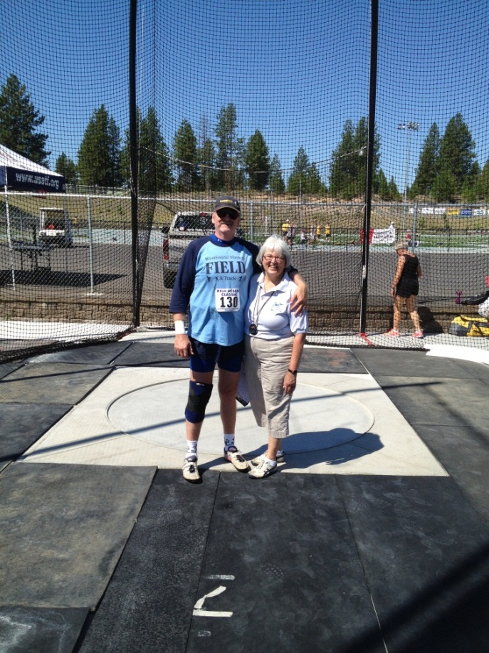
Throw Long and Strong
We hope your time with us was beneficial.
Best of Good Luck in the coming season!

